Slide 1


Graphic Era Hill University, Dehradun

Slide 2
Cloud based project on Webpage Development (CSE III Semester Mini project) 2020-2021
Submitted to:
Submitted by:
Ms. Preeti Chaudhary
(CC-CSE-D-III-Sem)
Guided by:
Ms. Himani Sivaraman
(Resource Person)
Disha Chauhan
Roll No.: 1918330
B.Tech(CSE)
Section: D
Semester: III

Slide 3
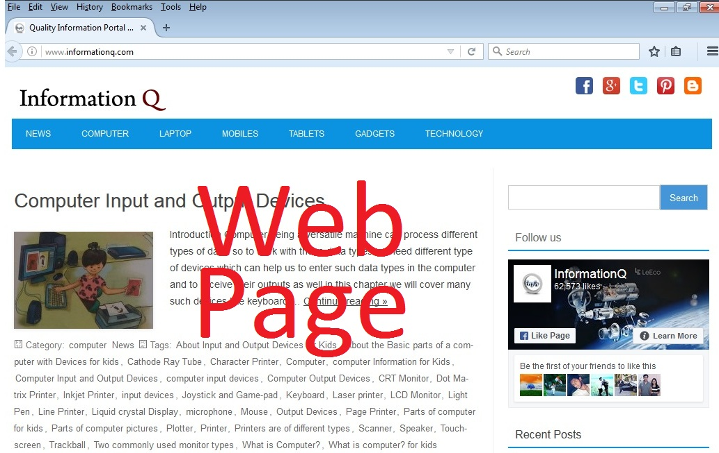
Introduction
Web development is the work involved in developing a Web site for the Internet (World Wide Web) or an intranet (a private network). Web development can range from developing a simple single static page of plain text to complex Web-based Internet applications (Web apps), electronic businesses, and social network services. A more comprehensive list of tasks to which Web development commonly refers, may include Web engineering, Web design, Web content development, client liaison, client-side/server-side scripting, Web server and network security configuration, and e-commerce development

Slide 4
Language for developing web page
As you can create webpage from any of these- HTML, CSS, JS.
CSS is used hand in hand with HTML to add colors, backgrounds, layouts, font sizes, and more. This language is a core technology web developers use to design and build websites. Java is the most popular web programming language. It is used to develop website content, games, apps, and software.
HTML, stands for Hypertext Mark up Language. It allows the user to create and structure sections, paragraphs, headings, links, and block quotes foe web pages and applications.
CSS stands for Cascading Style Sheets. CSS describes how HTML elements are to be displayed on screen, paper, or in other media. CSS saves a lot of work. It can control the layout of multiple web pages all at once. External style sheets are stored in CSS files.

Slide 5
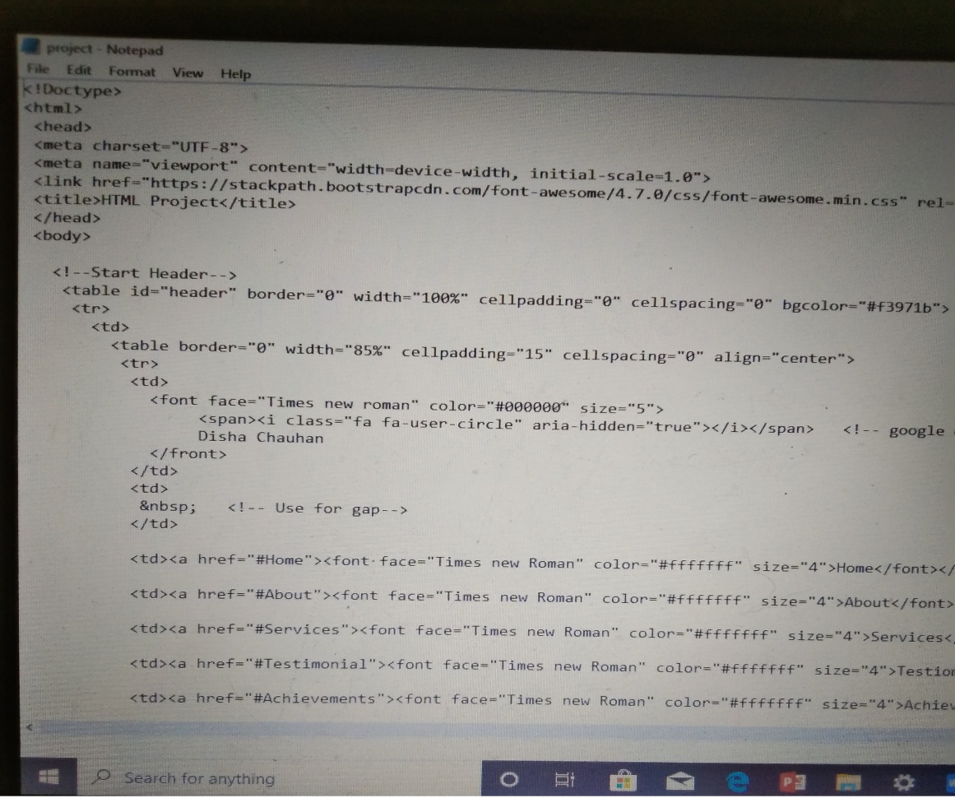
Steps to create & launched the webpage
I have used HTML here to create the webpage.
Write the code first

Slide 6
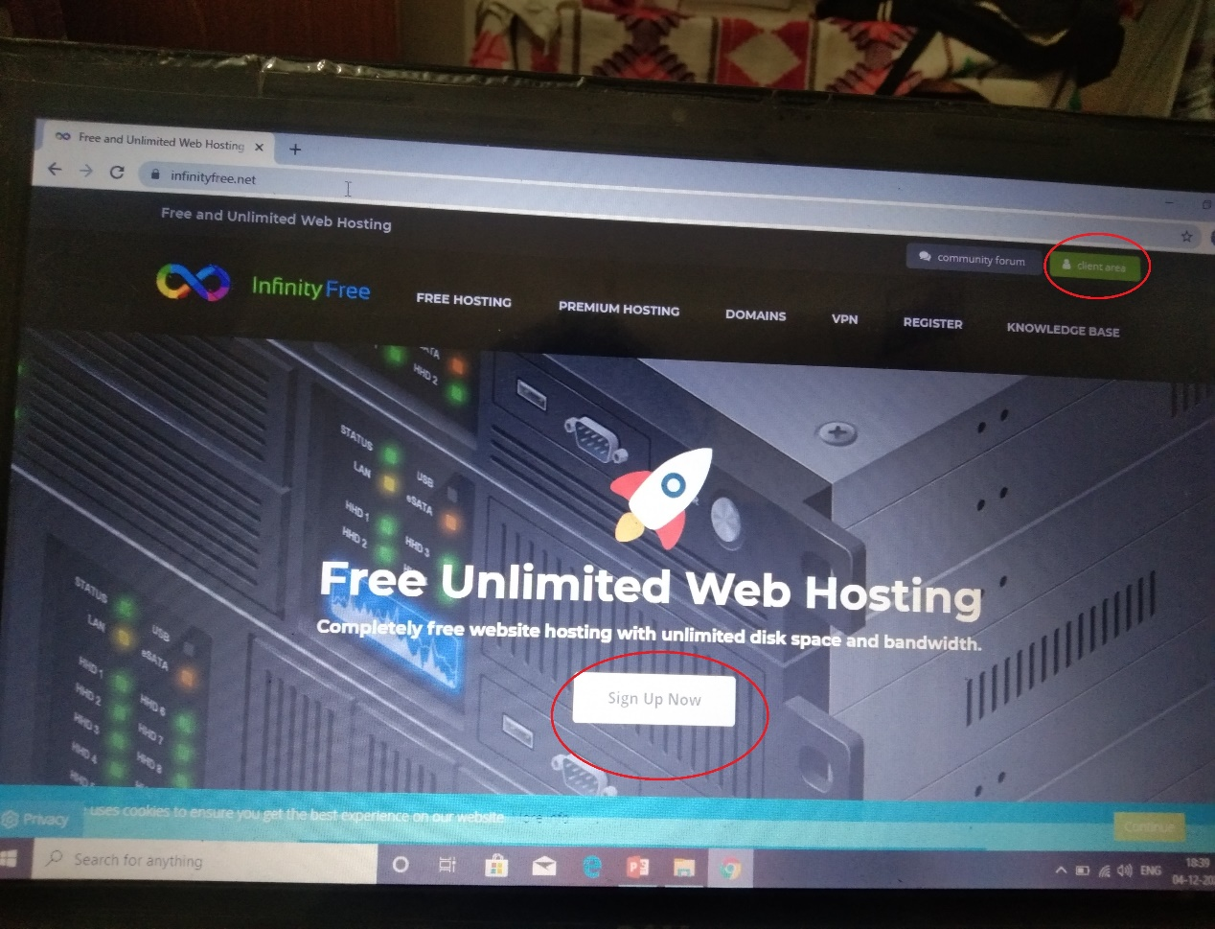
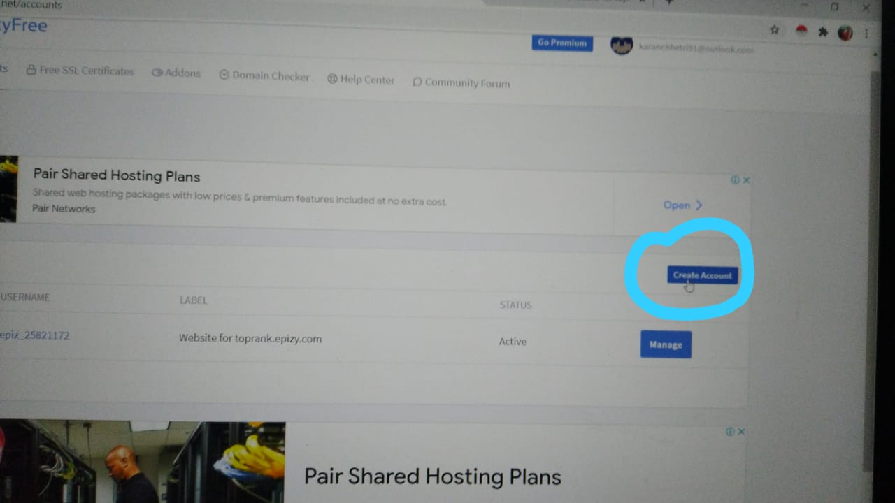
After creating, launched your page on
https://infinityfree.net/

Slide 7
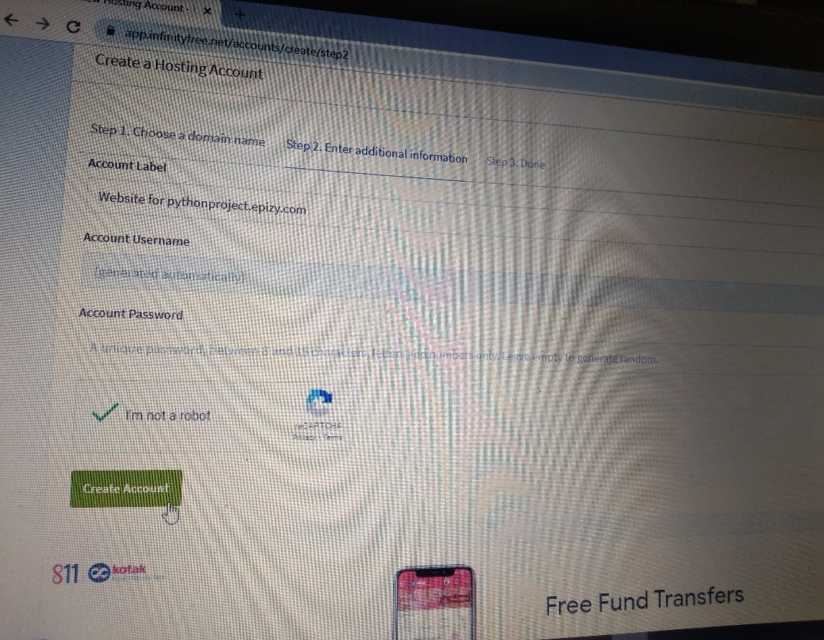
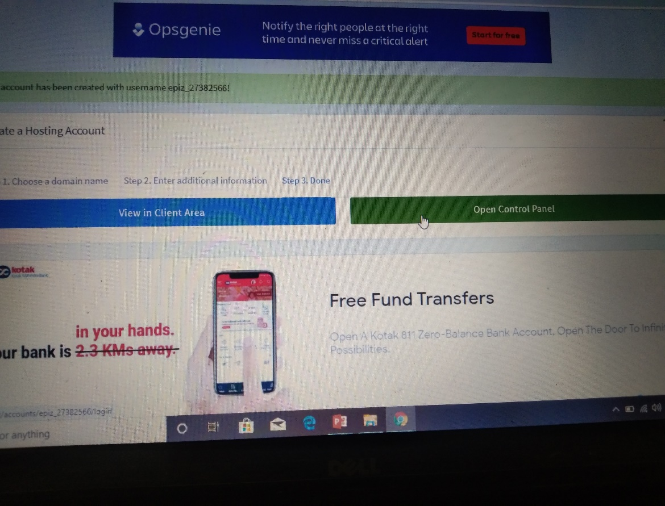
Fill Domain & Subdomain
Click on Control Panel

Slide 8
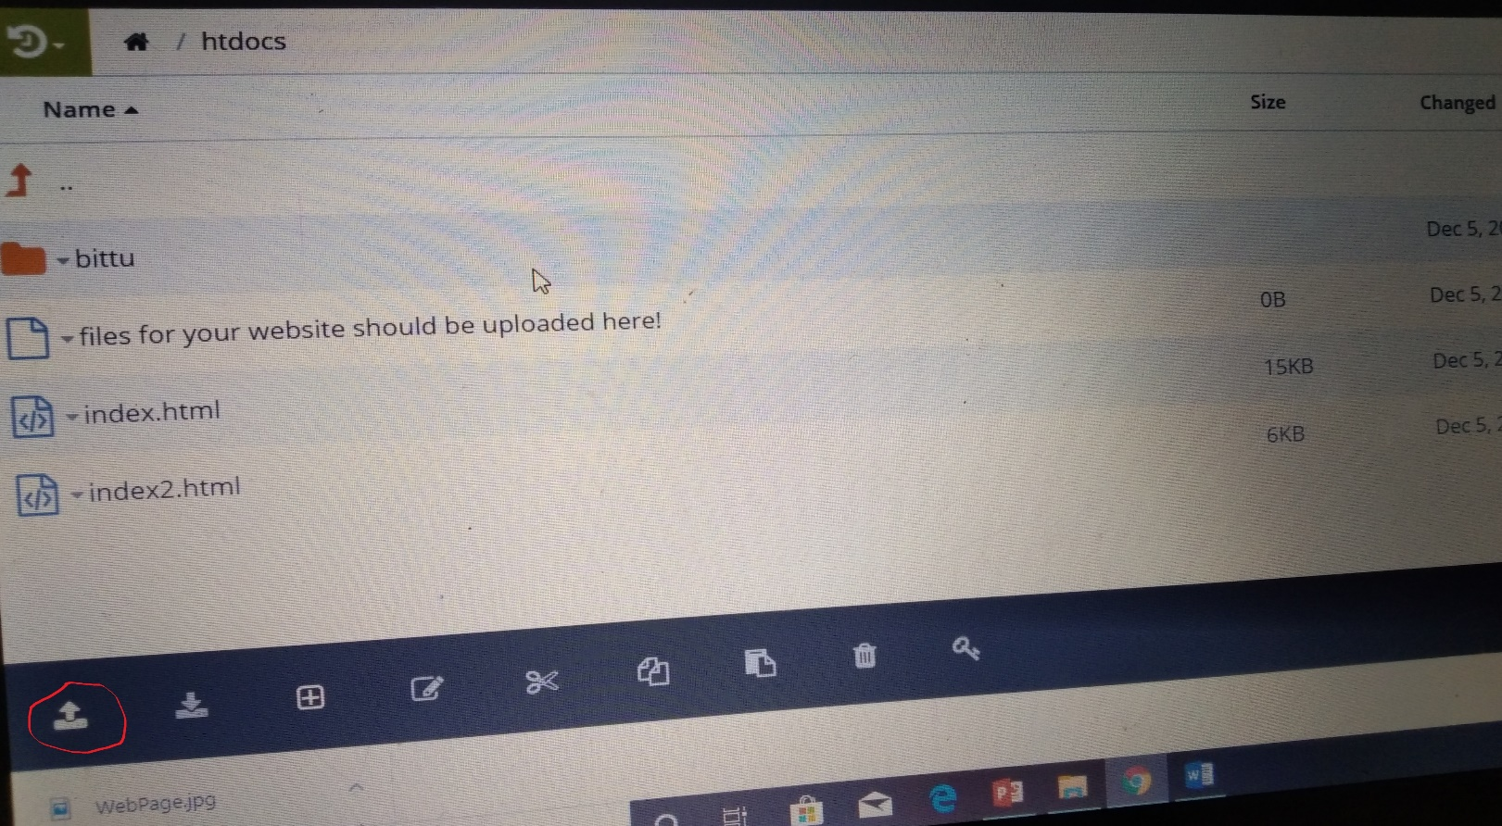
Upload your program file & images related in file

Slide 9
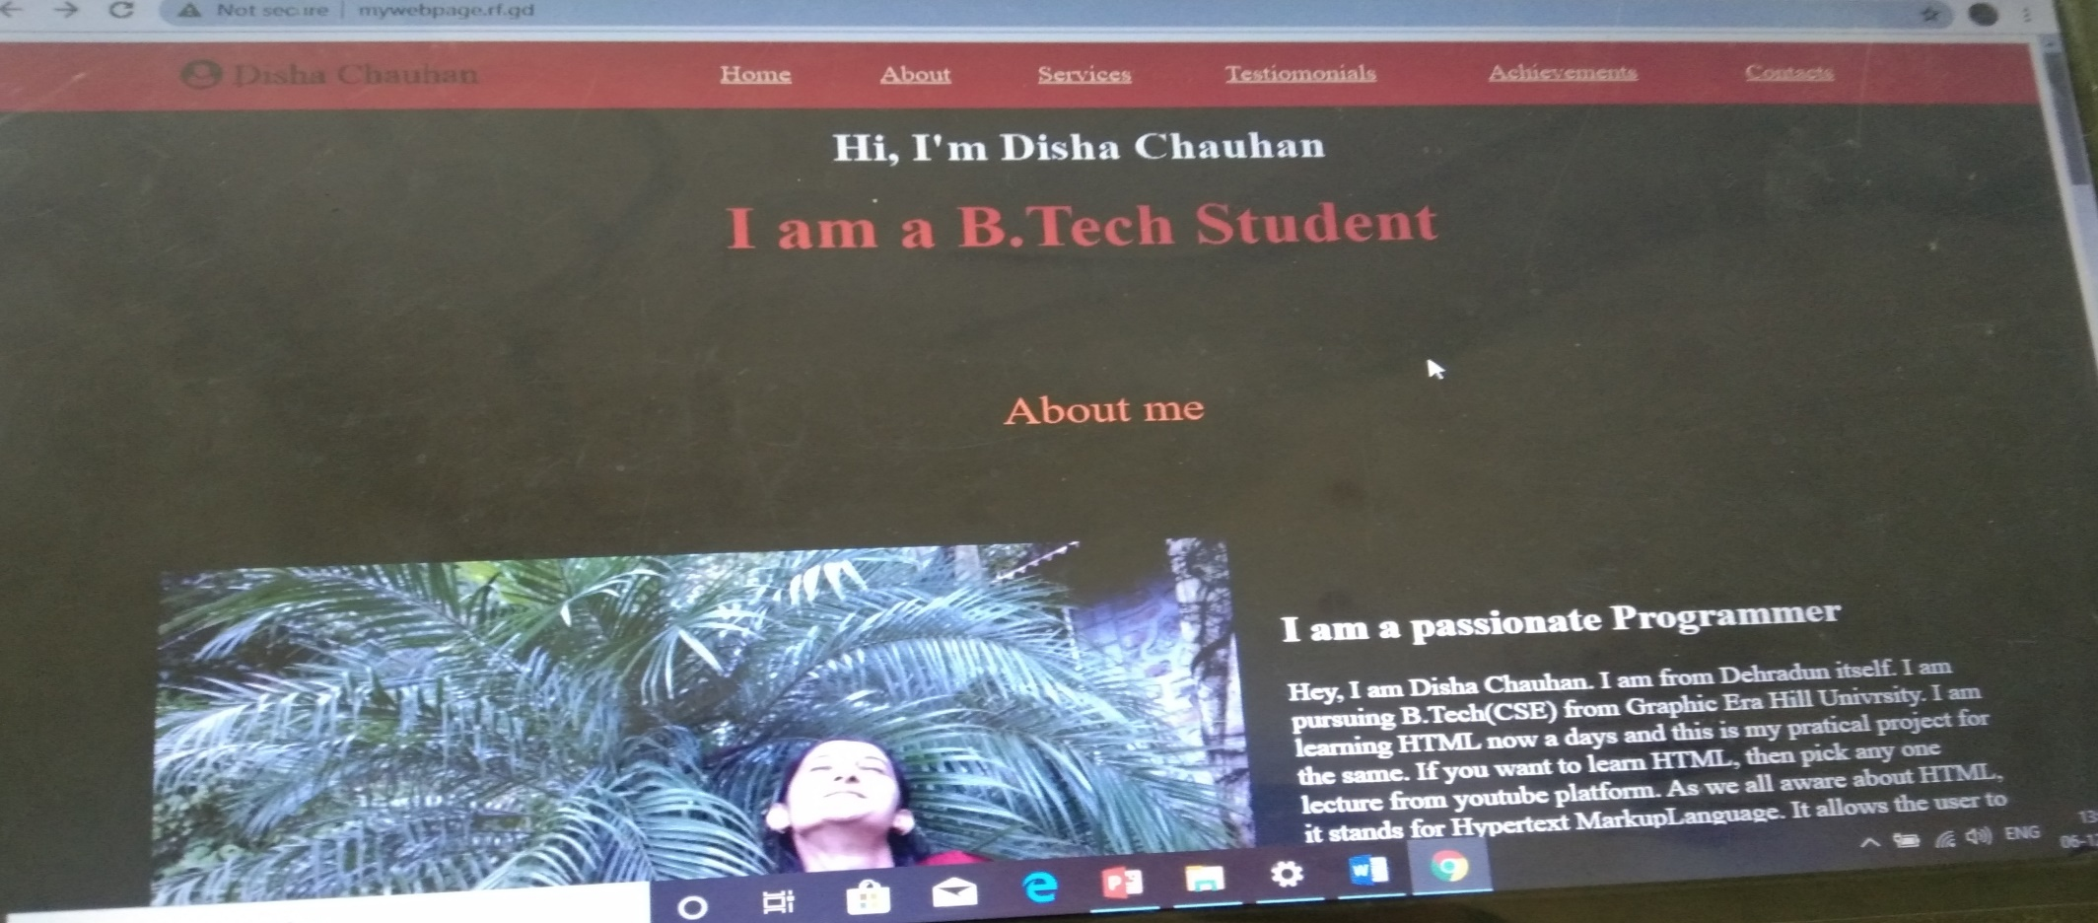
Now you will got ‘url’ for your webpage & you can easily access your web through it.

Slide 10
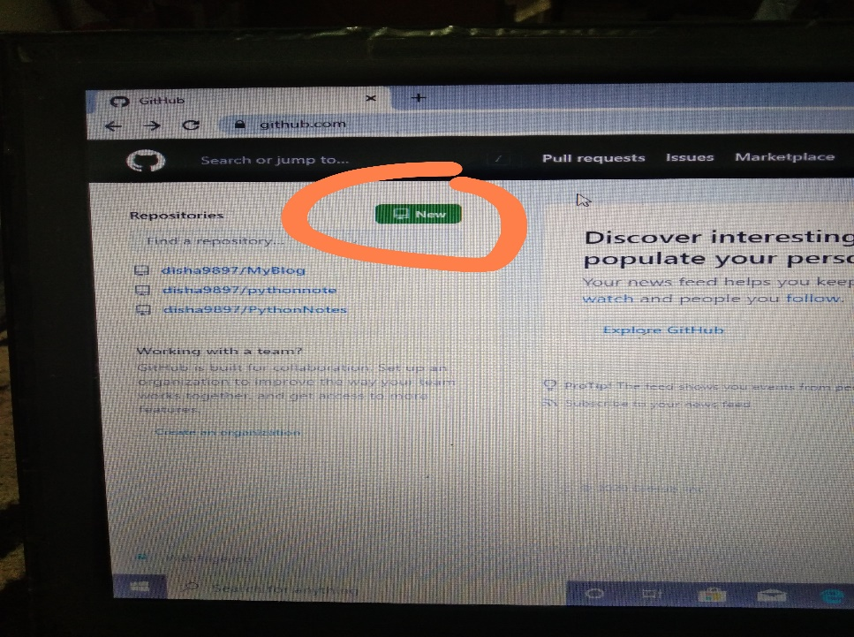
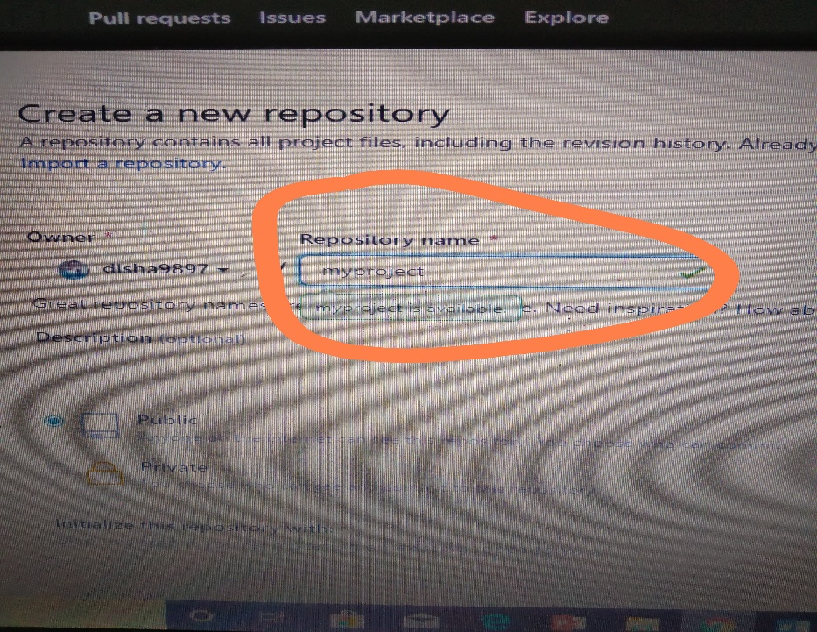
Step for uploading code on cloud like github
Click on ‘new’
Create a new ‘Repository’

Slide 11
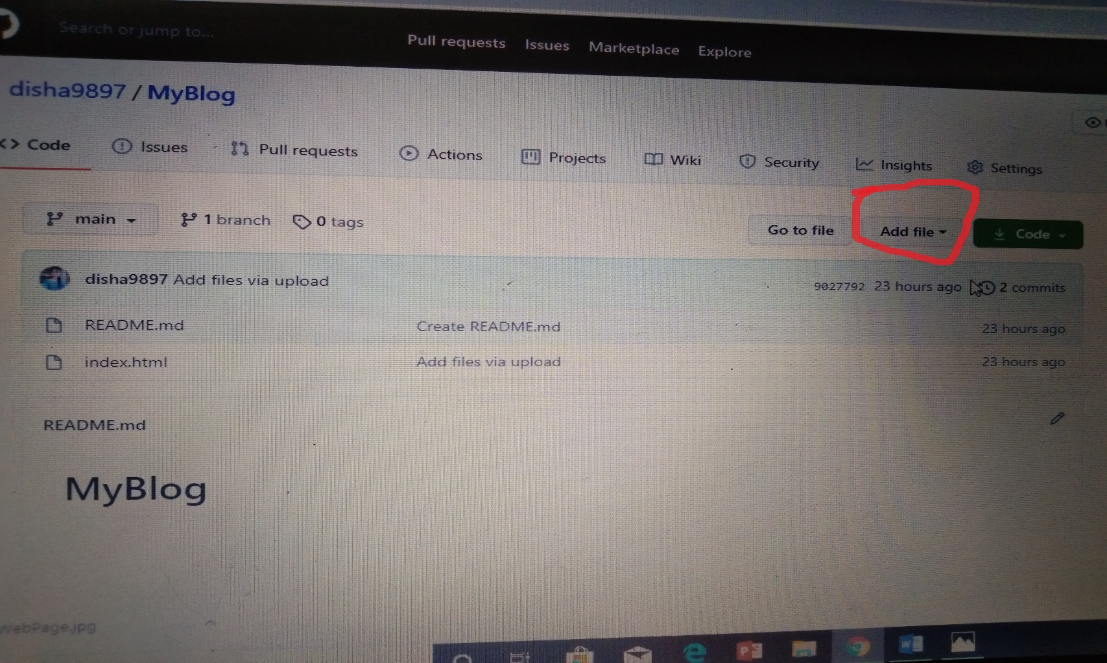
Upload your code by clicking on ‘Add file’

Slide 12
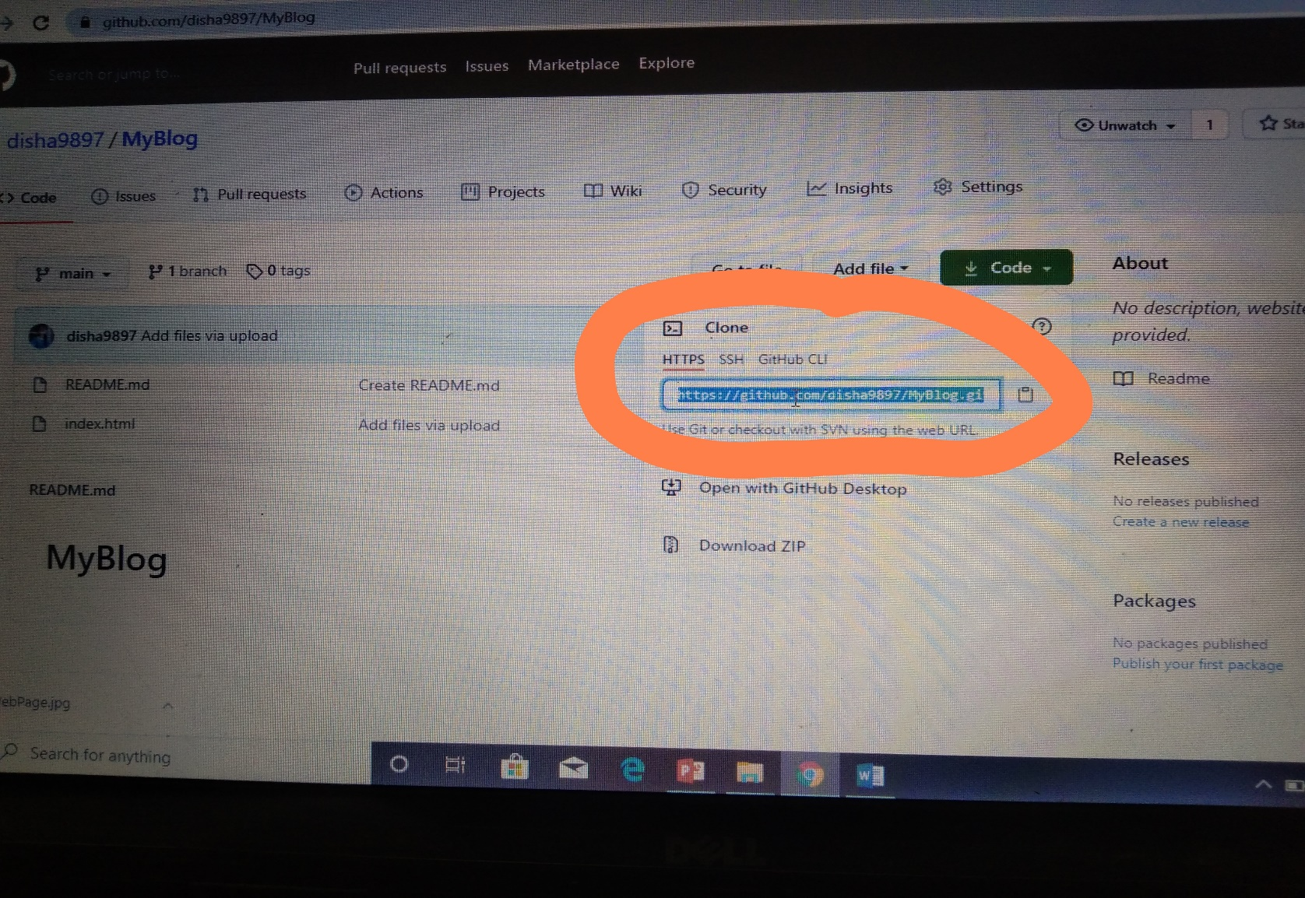
You can provide your code to others

Slide 13
Achievements and learnings
achievements
Learning
Keep in mind, the website is not a showcase, it is an interface that serves a function conveying useful information about a business to the users. Those functions might be delivering informative content, providing services or products, entertainments and more. Whatever the function holds, you should carry on design to fulfil it.
Develop skills in analyzing the usability of a web site.
Learn the language of web: HTML & CSS.
Learn techniques of responsive web design, including media queries.
Develop basic programming skills using Javascript and jQuery.
Be able to embed social media content into web pages.

Slide 14
Goals
The goals of creating webpage is to learn something new. It’s easy to get into the habit of just maintaining your site as you want. You may update your content, add blog posts now and then, and even keep on eye on your webpage traffic.
What website goals should you set?
Start blogging regularly.
Increase social mentions.
Raise your conversion rate.
Increase your email subscribers.
Make your website more accessible
.

Slide 15
Conclusion
The purpose and objective of webpage is to learn something new. By many ‘Tags’ of HTML, webpage designing is easy and in a aesthetic form. Flexibility in designing makes user explore their imagination and, thus even a novice user can dream and accomplish their wish of web page designing.
Web designing or web development is a short term professional job oriented course. There are huge opportunities available for the students who want to work in this field. Many private and public organizations hires web designer for their online work and website development. The back end developer is a person who is responsible for the back end development that interacts with the server. This type of web developer specializes in the languages like HTML, Php, ruby, ASP.Net, Java, Cold Fusion, Perl.

Slide 16
Thank you

